Slide 1
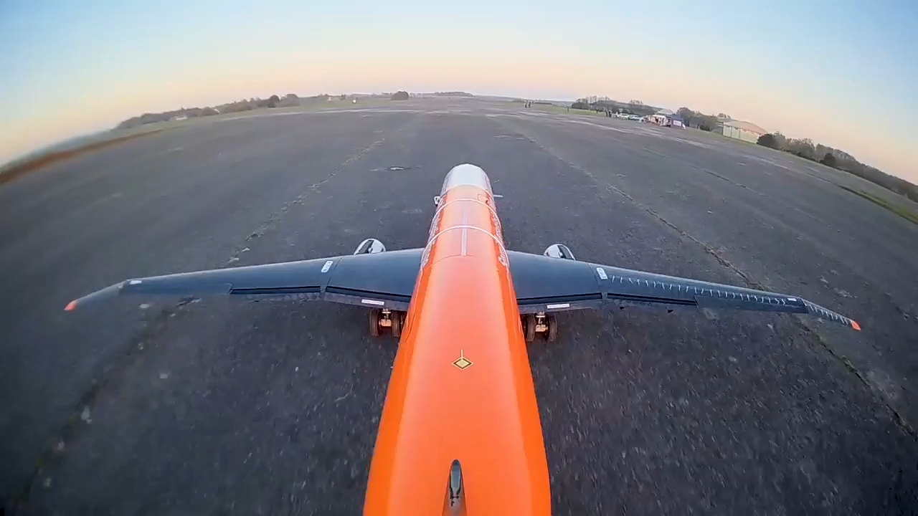

Loads and flutter sensibility to semi-aeroelastic
hinged wing parameters
Tutor : Joseph Morlier
Carlos Nicolás Juarez
Francesco Marzagalli
Projet Innovation-Recherche
FORMATION INGÉNIEUR ISAE-SUPAERO
Notes:
Title
Brief presentation of AlbatrosONE and hinge device

Slide 2
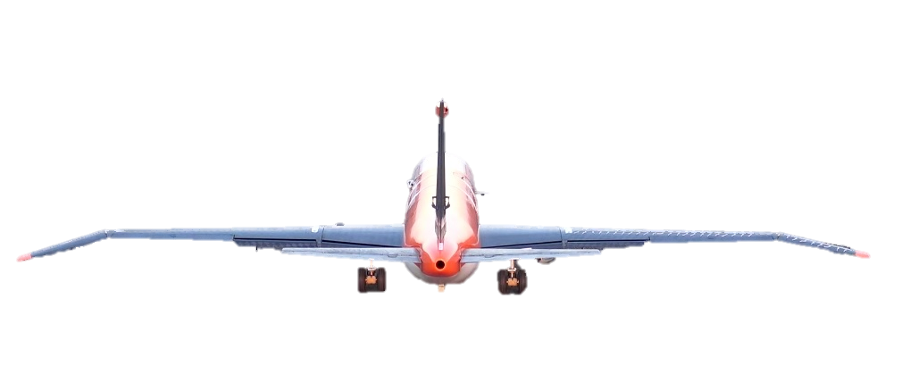
INTRODUCTION
/ Motivation
Increasing Wingspan
Lift induced drag reduction
Problems
Solution: Hinged Wing
maximum aircraft dimensions allowed at airports
increase in bending moments along the wing
Can be folded while grounded
Load alleviation at the root of the wing
Notes:
Much work has been done for drag reduction

Slide 3
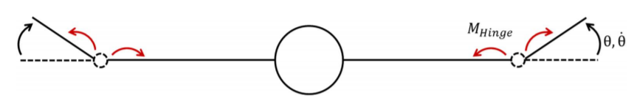
OBJECTIVES
Hinge stiffness
Hinge position
Finding a way to introduce the hinge device into the structural model to reproduce the behaviour of the wingtip
Study how hinge presence affects the wing loads and flutter
Bi-objective problem :
Maximum load alleviation
Flutter avoidance

Slide 4
STATE OF ART
Small scale flying demonstration of semi aeroelastic hinged wing tips
Zero stiffness is an ideal best case for load alleviation
Difficulties in managing the wingtip release
Low stiffnesses generates a dynamic damping effect beneficial for flutter
AlbatrossONE: Practical application that showed consistent results with the theoretical work
Wilson, T., Kirk, J., Hobday, J., & Castrichini, A. (2019).
Preliminary investigation of use of flexible folding wing tips for static and dynamic load alleviation
Castrichini, A., Siddaramaiah, V. H., Calderon, D. E., Cooper, J. E., Wilson, T., & Lemmens, Y. (2017).
The Aeronautical Journal, 121(1235), 73-94.
Aeroelastic behaviour of hinged wing tips
Wilson, T., Azabal, A., Castrichini, A., Cooper, J., Ajaj, R., & Herring, M. (2016).
Notes:
why its ideal
releasing the wingtip during gusts
mode details about AlbatrossONE

Slide 5
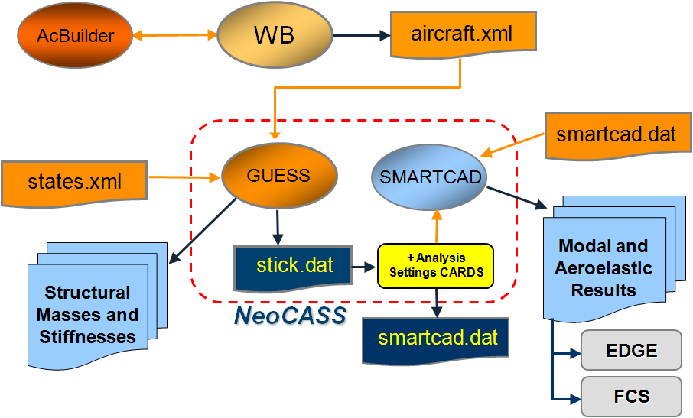
NeoCASS/ Next generation Conceptual Aero‐Structural Sizing Suite
It Is a collection of Matlab ® analysis modules for:
Initial aircraft structural sizing
Modal analysis
Linear/non‐linear static analysis
Aeroelastic analysis (static aeroelasticity, flutter)
‘Flexible’ Aerodynamic stability derivatives.
Interfaced to:
External codes (Edge‐FOI, MSC/NASTRAN, others)
Website
https://www.neocass.org/
Notes:
Introduction of NeoCASS
How its made
purposes

Slide 6
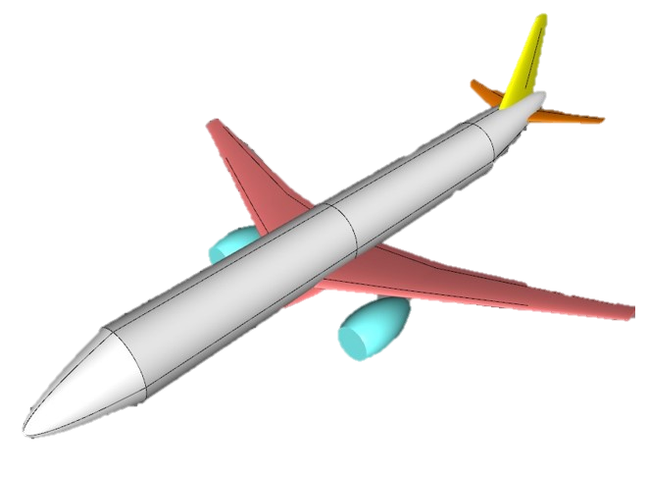
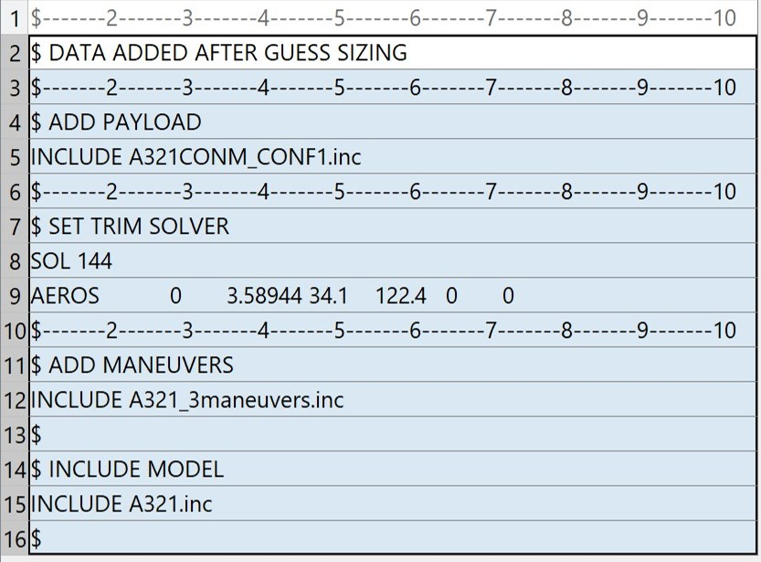
AIRCRAFT MODELLING
/ Loads analysis
Low fidelity model
2 models inspired by Airbus A321 used:
No hinge, and no wingspan extension
Hinge and wingspan extended by 25%
Types of analysis:
Aeroelastic trim
Cruise: Mach 0.78 - Altitude = 11000 m
Pull-up: Mach 0.25 - 2g
Gust dynamic analysis: Mach 0.78 - Air density = 0.32
Notes:
How the model ware done

Slide 7
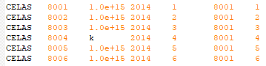
HINGE MODELLING
/ Loads analysis
Hinge implementation between nodes “2014” and “8001”
Node 2014
Node 8001
CELAS
Nastran scalar element used to model springs
Hinge stiffness is given to the rotation around “x” axis
Notes:
Make double the node where the hinge is going to be located
Restoring the link between the nodes with elastic cupling
Celas element

Slide 8
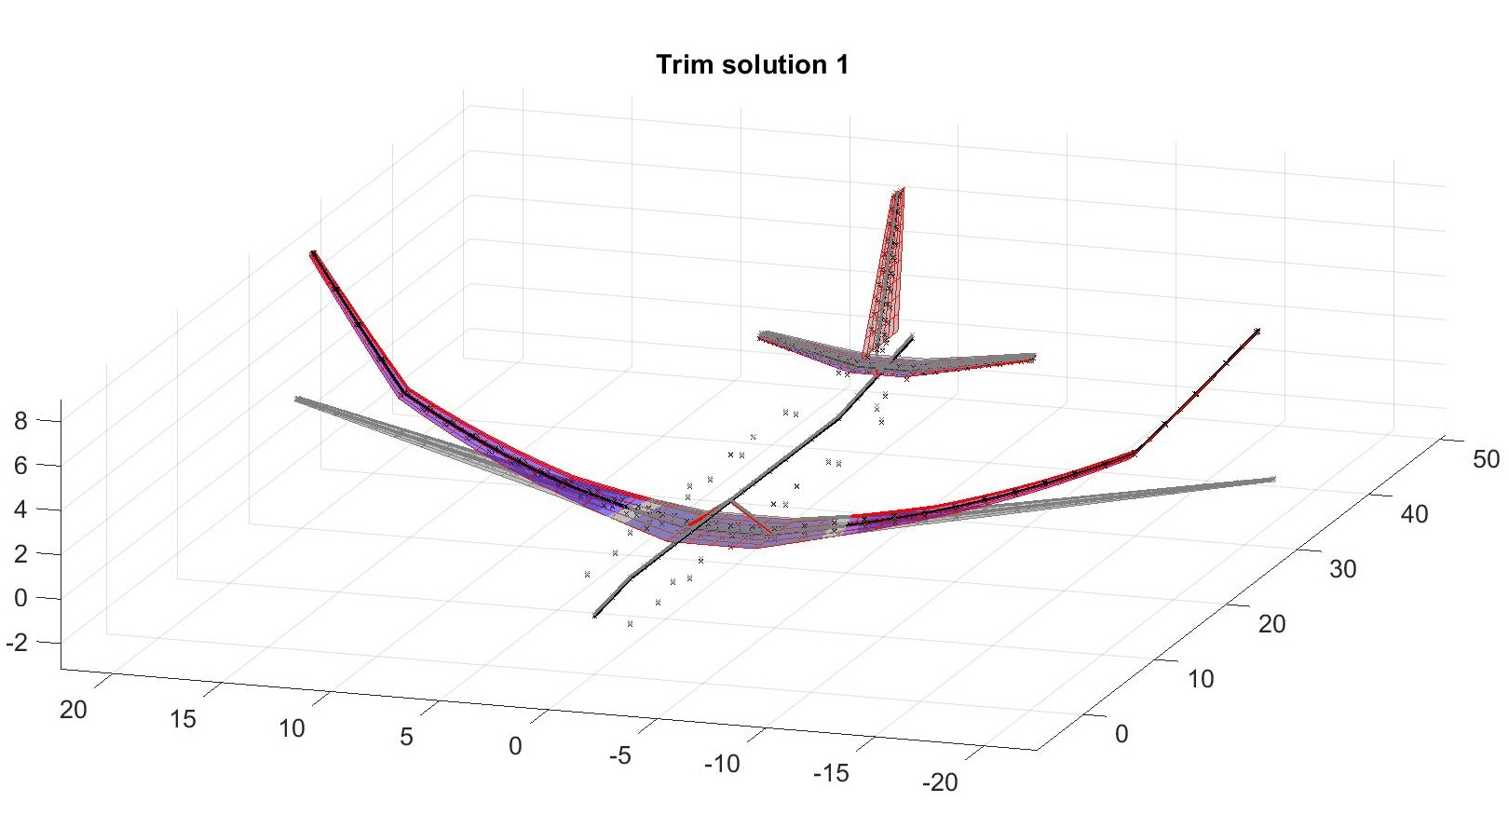
HINGE CONFIGURATIONS
/ Loads analysis
20 Combinations considered
Best results presented in the following slides
Hinge position
75%
81%
84%
88%
93%
Hinge stiffness [Nm/rad]
1e+03
1e+04
1e+05
1e+06
Notes:
Celas worked
Ideas for the analysis with different combinations

Slide 9
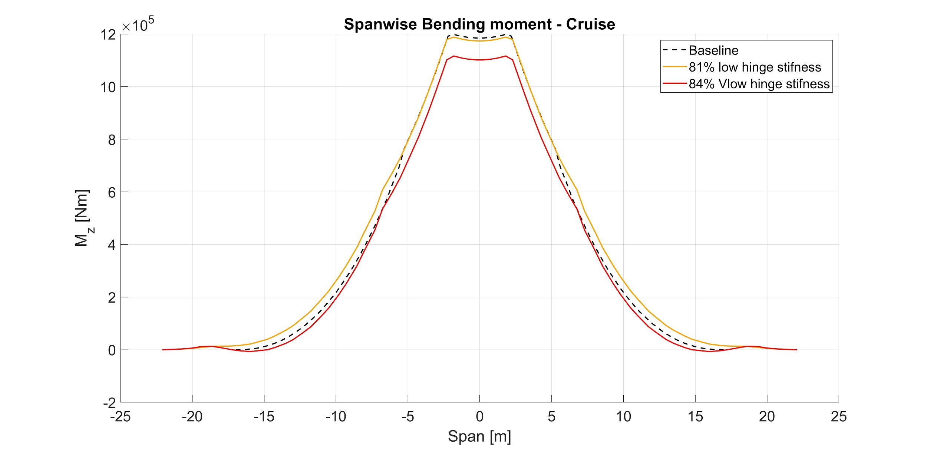
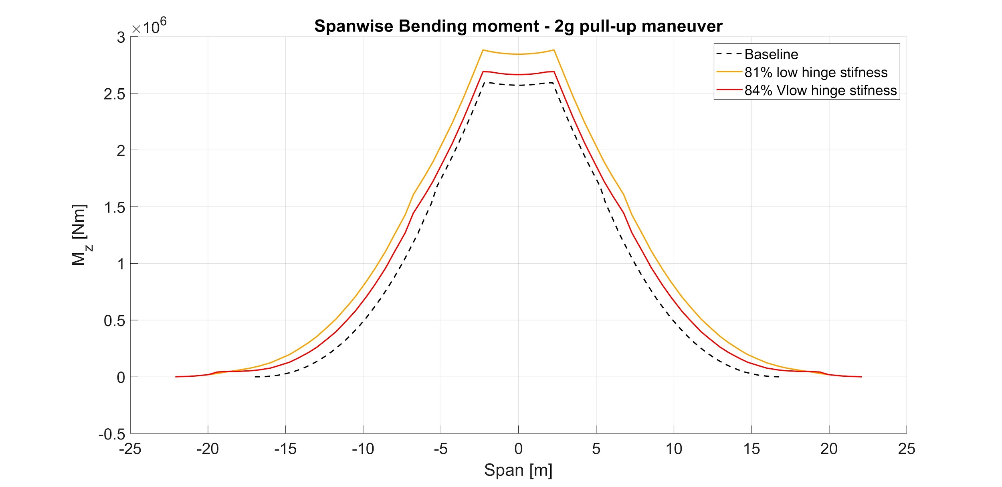
TRIM BEST RESULTS
/ Loads analysis
Wing root bending moment comparison:
-1%
-7%
(wrt baseline)
Wing root bending moment comparison:
+11%
+3.8%
(wrt baseline)
Notes:
Presentation of main results
Explain the graphs

Slide 10
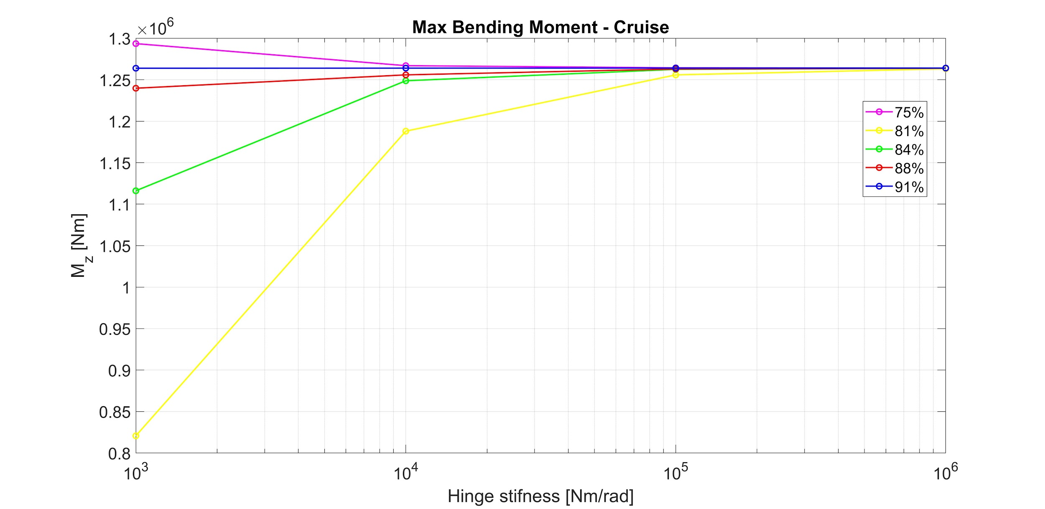
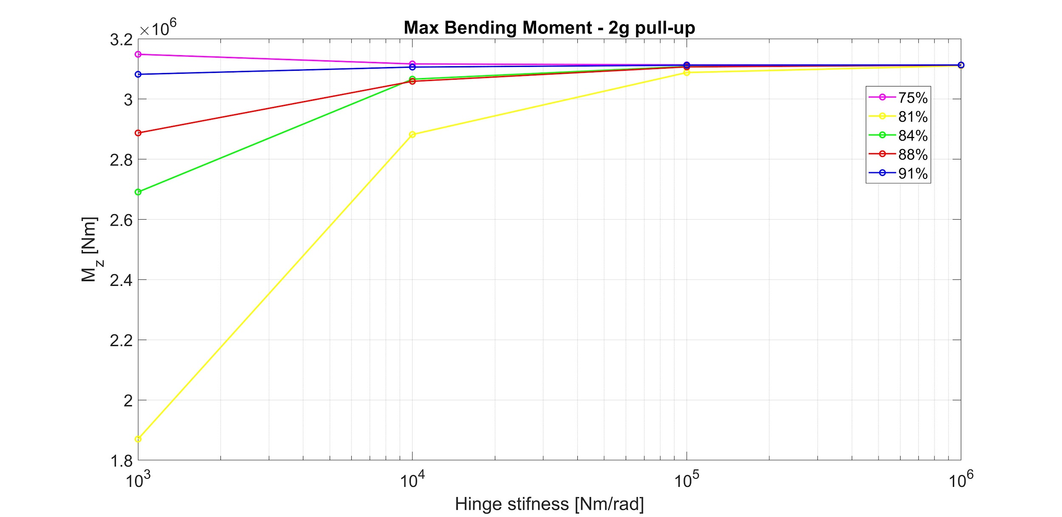
TRIM TREND RESULTS
/ Loads analysis
Among the 20 configurations considered the best are those equipped with very low or low hinge stiffnesses
Mas WRBM shows a similar trend for both flight conditions, except for one case (hinge at 75%), for increasing hinge stiffness or span position

Slide 11
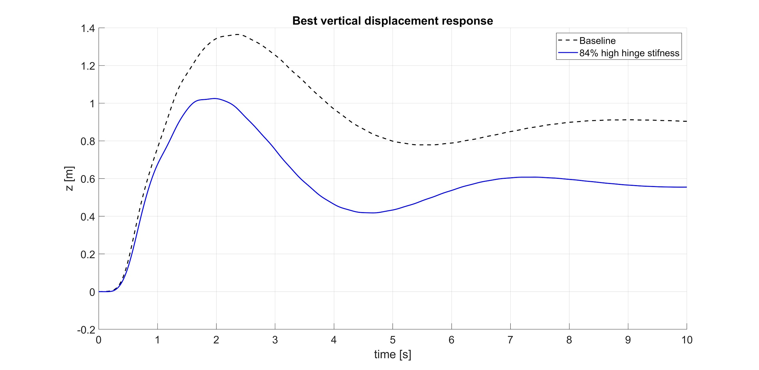
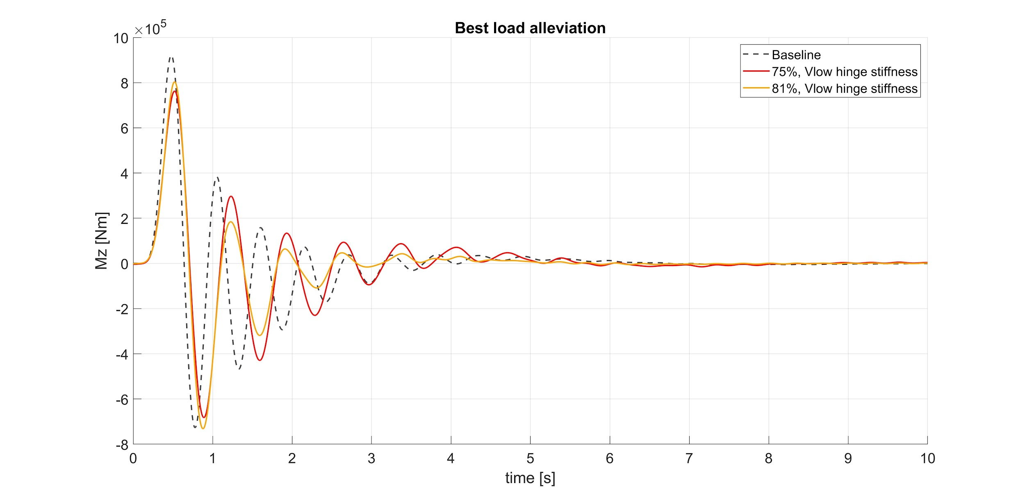
GUST BEST RESULTS
/ Loads analysis
All the combinations are beneficial for maximum vertical displacement
Best result involves a decrease of 25%
Wing root bending moment alleviation:
-13% - 𝛇 = 0.23
-17% - 𝛇 = 0.15
(wrt baseline)
Notes:
damping - logarithmic decrement

Slide 12
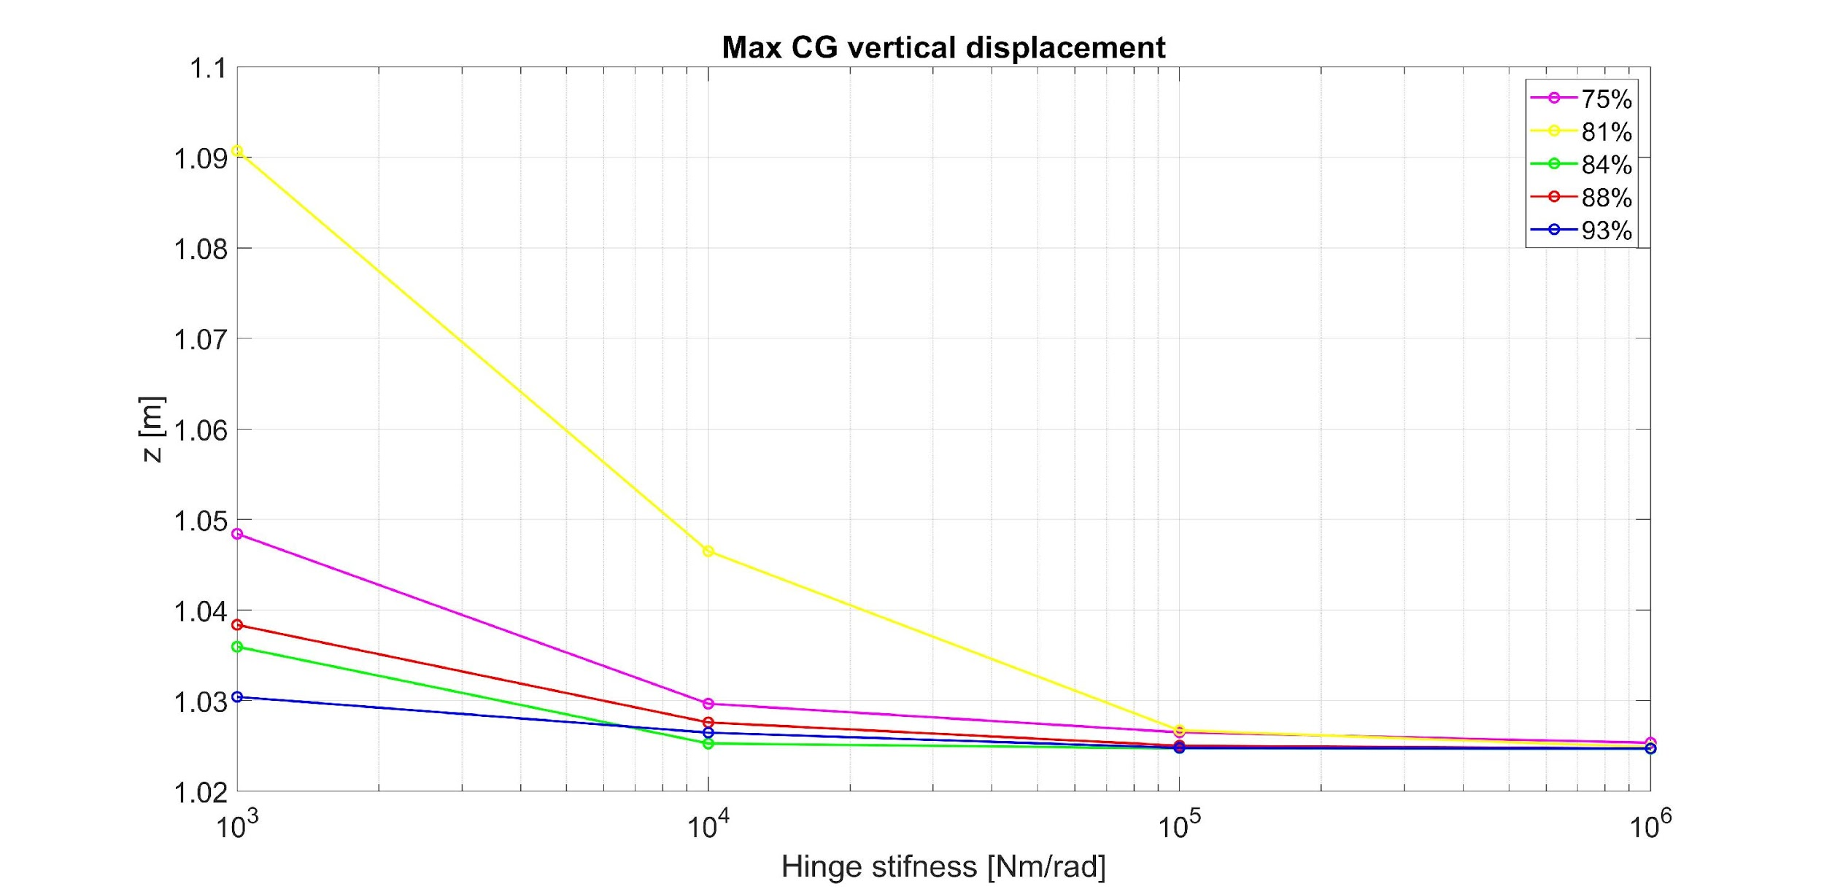
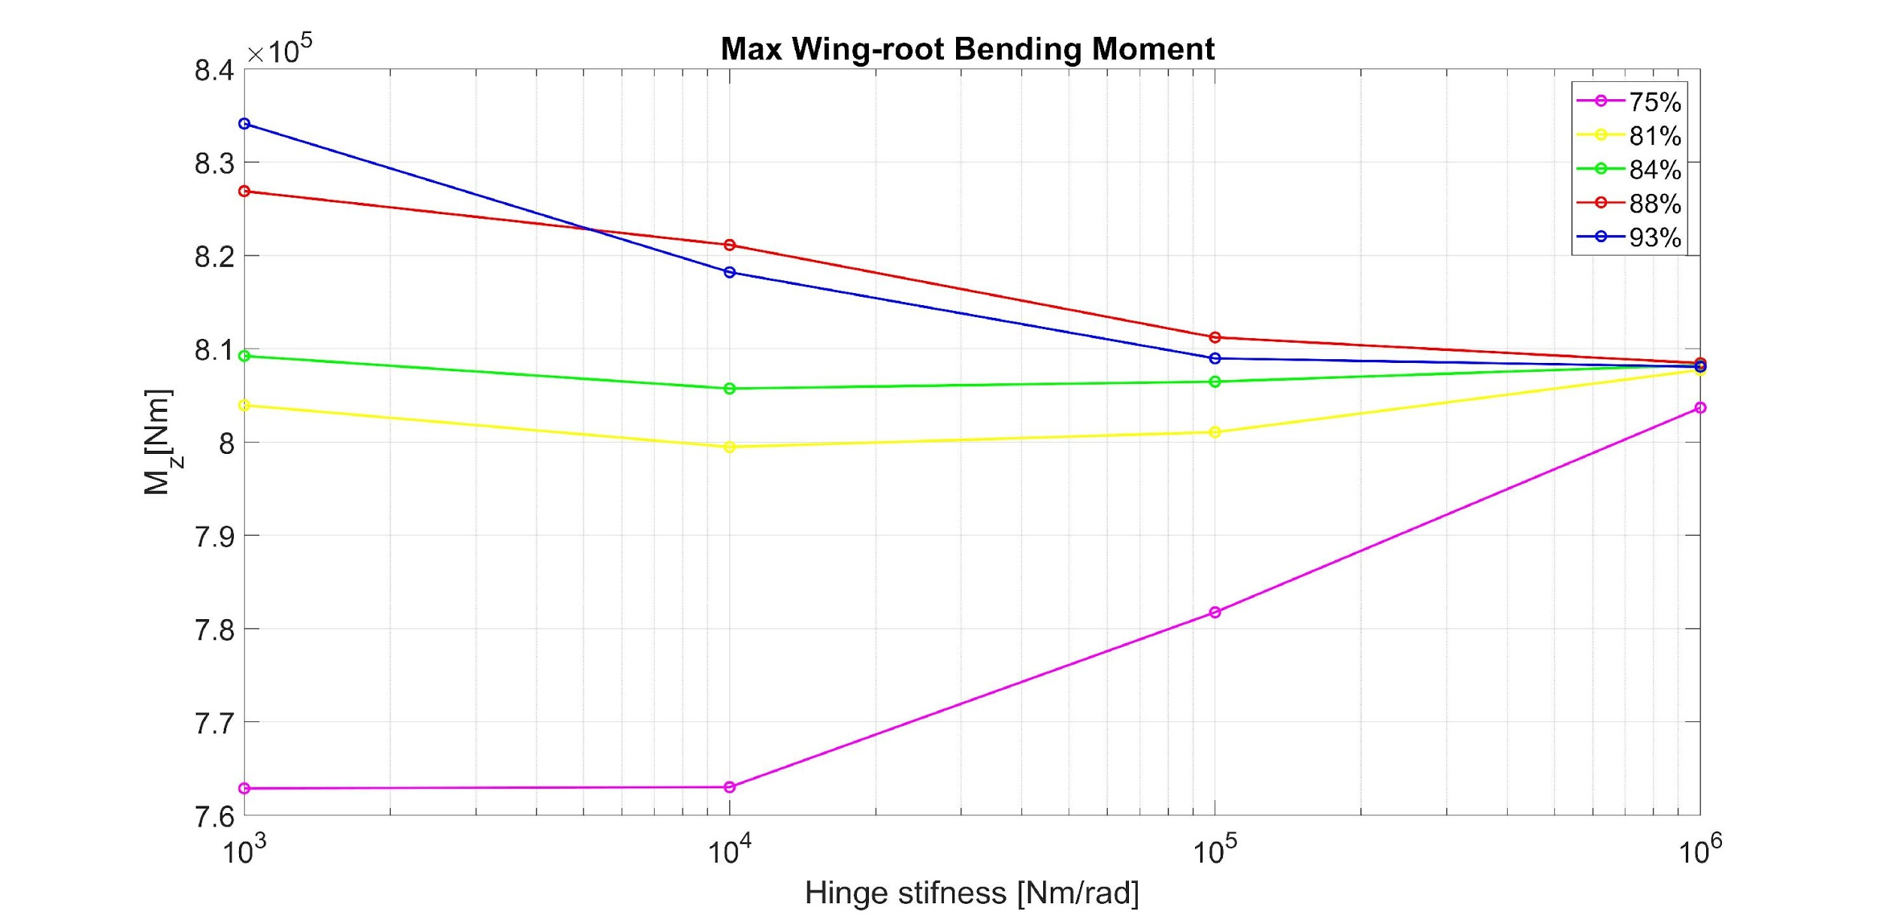
GUST TREND RESULTS
/ Loads analysis
High hinge stiffness proved to be better to minimize vertical displacement for all configurations.
A correlation between hinge position and stiffness can be noted.
Low hinge stiffness proved to be better to minimize WRBM for all configuration.
Unfortunately no clear correlation between hinge position and stiffness can be noted.

Slide 13
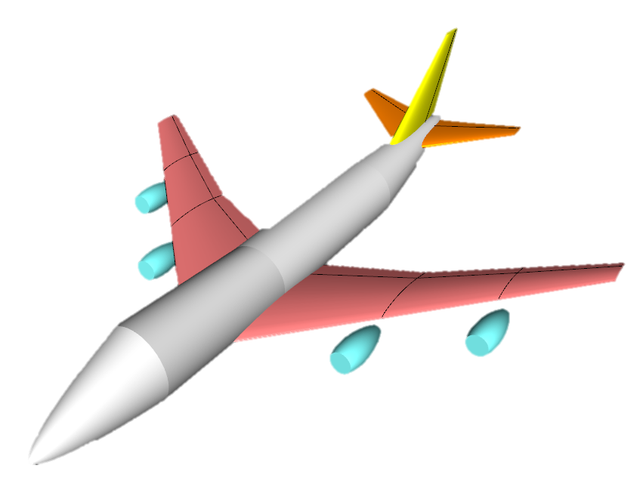
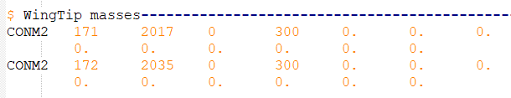
AIRCRAFT MODELLING
/ Flutter analysis
Low fidelity model inspired by Boeing 747
Hinge stiffness goes from 1e+04[Nm/rad] to 1e+10[Nm/rad]
Hinge position: 67%, 72%, 78%, 83%, 89% wrt wingspan
CONM2
Allows the specification of a concentrated mass
Mass addition to the wingtip
Wingtip mass is needed to evidence hinge stiffness influence
Notes:
747 already an example in NeoCASS
Stiffness values based on previous works
Need for the mass

Slide 14
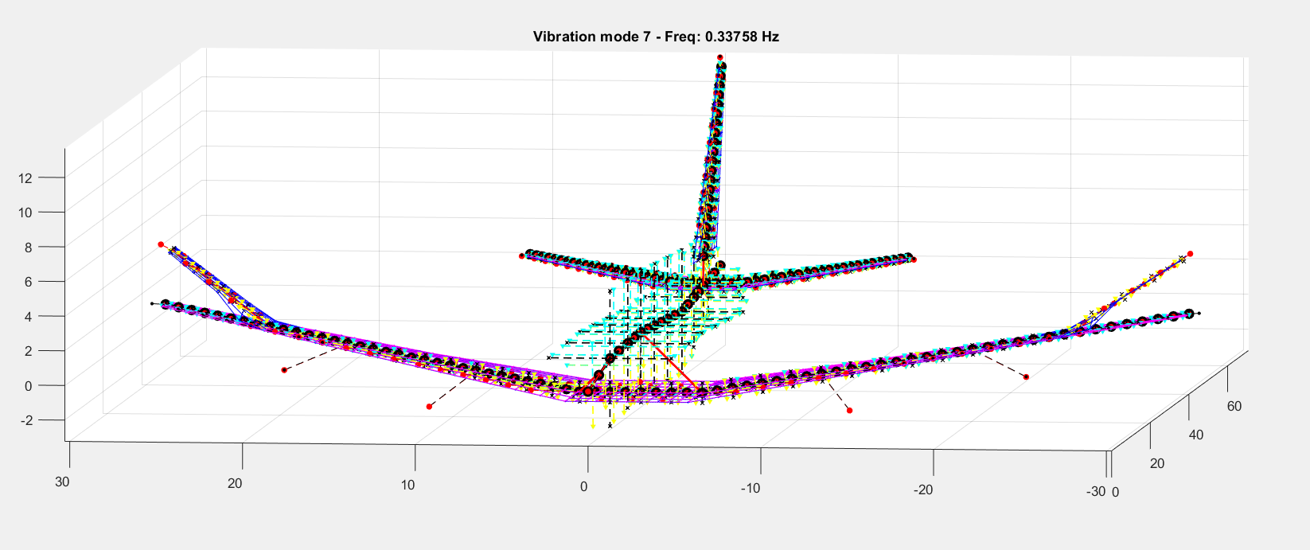
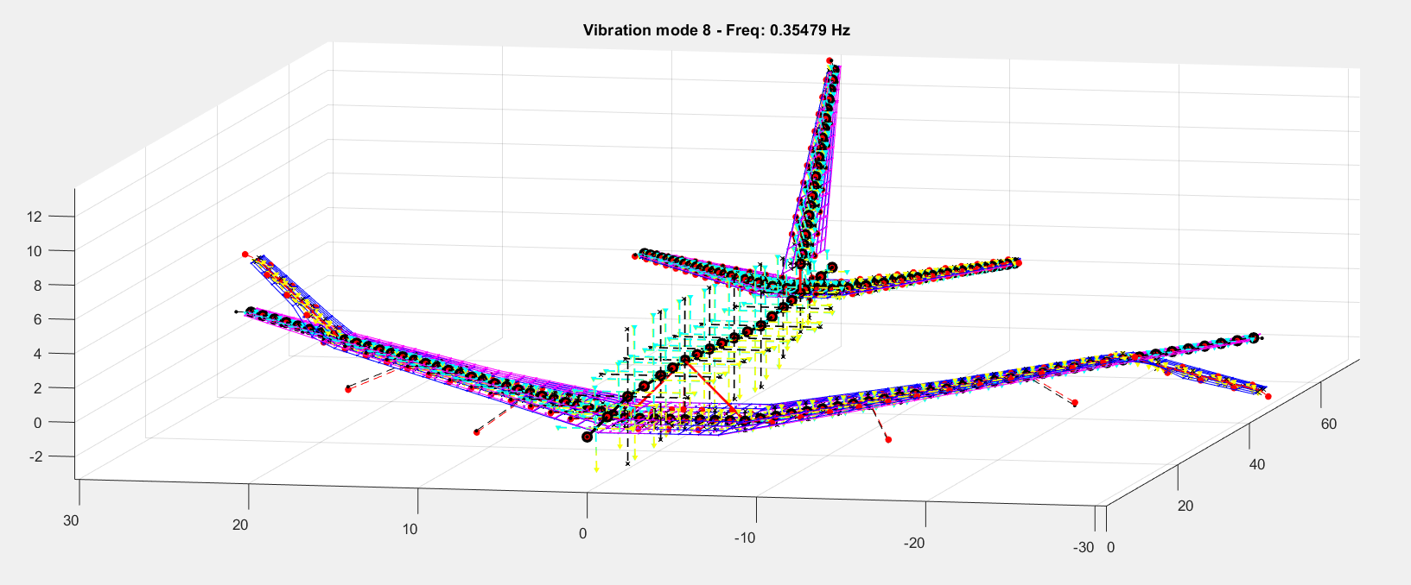
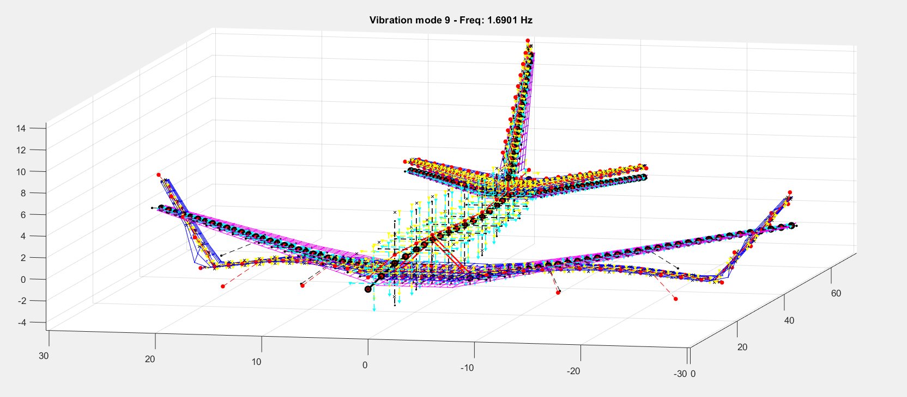
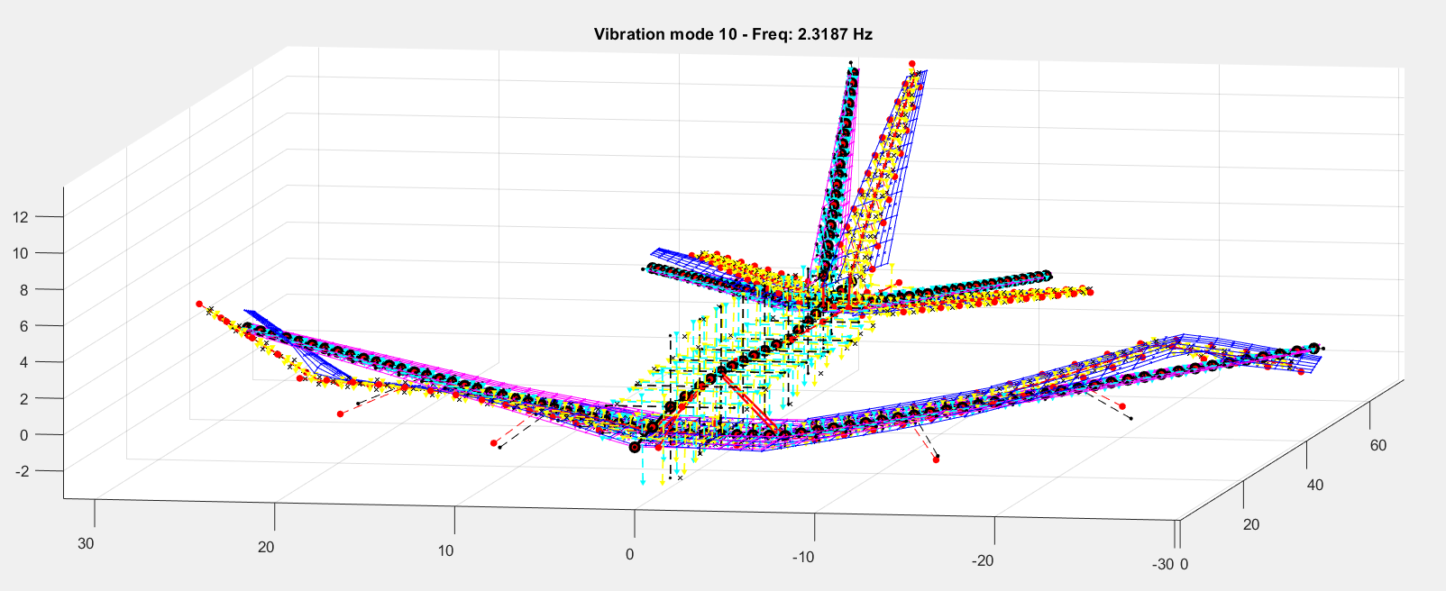
MODAL RESULTS
/ Flutter analysis
First modes for K_{hinge}= 1e+05 [Nm/rad] y_{hinge}= 0.78
Non- rigid modes
N° | Freq. [Hz]
7 | 0.3376
8 | 0.3548
9 | 1.6901
10 | 2.3187
11 | 3.439
12 | 3.5041
13 | 3.9006
14 | 4.1129
15 | 5.0978
16 | 5.205
17 | 6.4436
18 | 6.4626
19 | 7.59
20 | 7.978
Notes:
Mention the values of the case
First modes are wingtip modes
Remaining modes are combination between wingtip and main airframe deformations

Slide 15
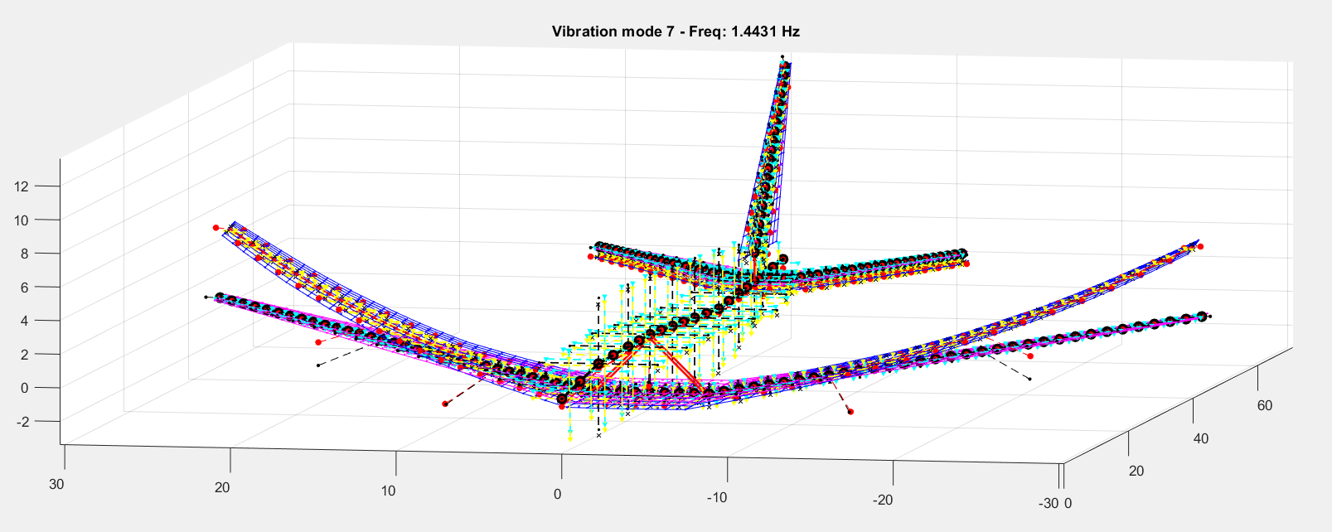
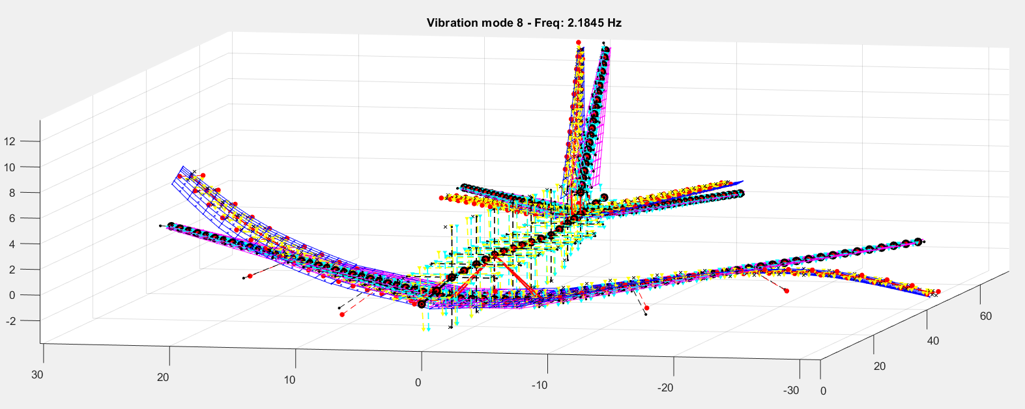
MODAL RESULTS
/ Flutter analysis
k_{hinge} = 1e+05 [Nm/rad]
Wingtip modes
Increasing hinge stiffness
k_{hinge} = 1e+08 [Nm/rad]
Wing modes
Notes:
First two modes tend to be more similar to the hingeless case modes when the stiffness is increased

Slide 16
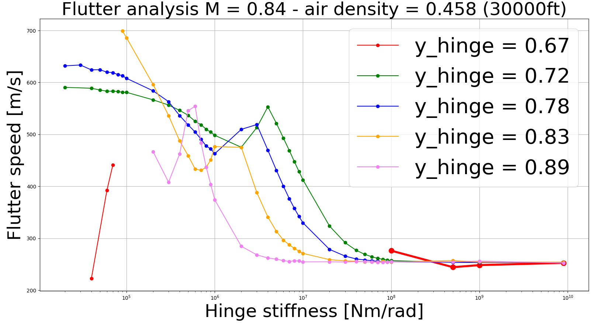
FLUTTER RESULTS
/ Flutter analysis
Flutter speed stracted from V-g plots for each design combination
Reducing stiffness and moving the hinge inward involve a stabilising effect
Convergence for high stiffnesses
Presence of a local maximum
Flutter analysis conditions:
Mach = 0.84
Air density = 0.46[kg/m³]
Notes:
Flight conditions
V-g V-f plots from NeoCASS. Flutter run for all the stiffness cases
No fluter for most of the cases when hinge at 67%
No convergence when stiffness is lower than 1e4

Slide 17
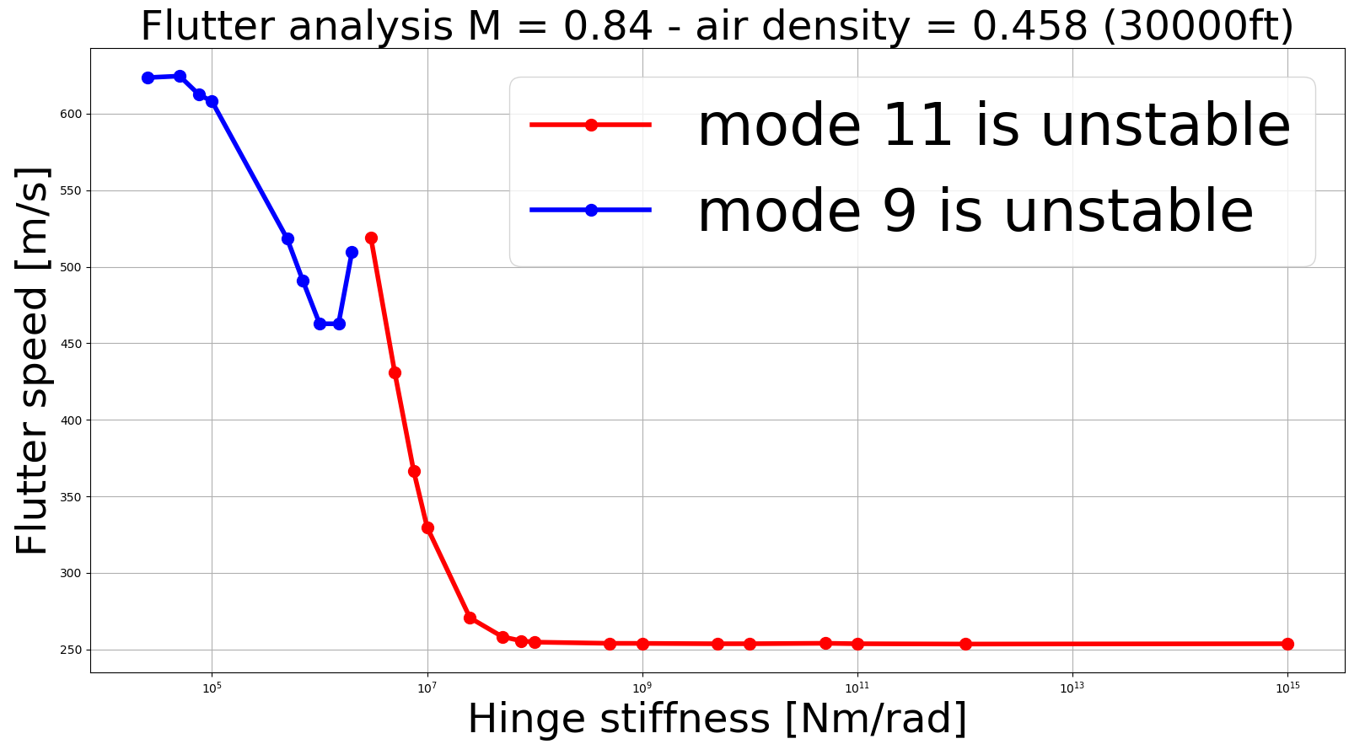
FLUTTER RESULTS
/ Flutter analysis
The unstable mode changes from low stiffnesses to high stiffnesses
Range: between 3e+05 [Nm/rad] and 4e+06 [Nm/rad]
Moving the hinge outwards decreases the position of the local maximum
Notes:
Case for hinge at 78%

Slide 18
CONCLUSIONS
Load analysis conclusions
Flutter analysis conclusions
For trim analysis, clear correlation between max loads and hinge design parameters
Same trends for two flight conditions considered
Best results are obtained around 80% of the wingspan and low stiffnesses
All hinge configurations were beneficial for gust analysis. Best results for low stiffnesses
Design parameters can be used to avoid flutter
High stiffnesses reduce flutter speed
Too low stiffnesses can produce instabilities
Moving the hinge closer to the wing root generates a stabilizing effect

Slide 19
MERGED CONCLUSIONS
Selected design parameters affect both load and flutter analysis
Low stiffness is better for load alleviation and flutter, but it has to be chosen carefully because too low values can produce instabilities.
Moving the hinge inwards is beneficial for both analysis
Both phenomenons showed similar trends wrt design configurations
Future works:
More design parameters(hinge angle and mass)
MDO application to find optimal design
High-fidelity models implementation
Notes:
► Important to know the trends the behaviour, qualitative results
►Recall the results (no convergence for low values)
► ►Qualitatively the trends are the same, no need to find a compromise
♫ Flare angle definition

Slide 20
Thank you!

